Slide 1

Sales Data project
Sheetal Kumari
Nov 2019 batch
Tableau Project

Slide 2
Data Source & Description
Sales Data
Sales of Products contains vehicles like cars, trains, motor, Plane, Ships, Truck & Buses.
Sold Worldwide.

Slide 3
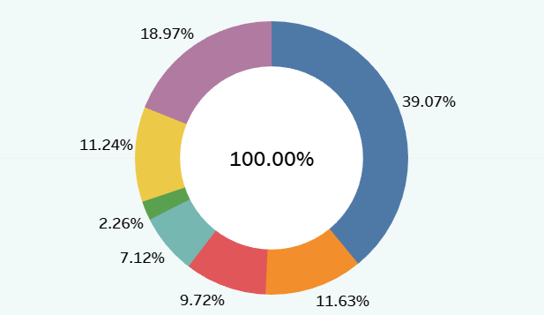
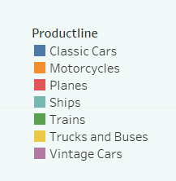
Highest & lowest selling Product
Highest Sales:
Classic Cars
Lowest Sales:
Train

Slide 4
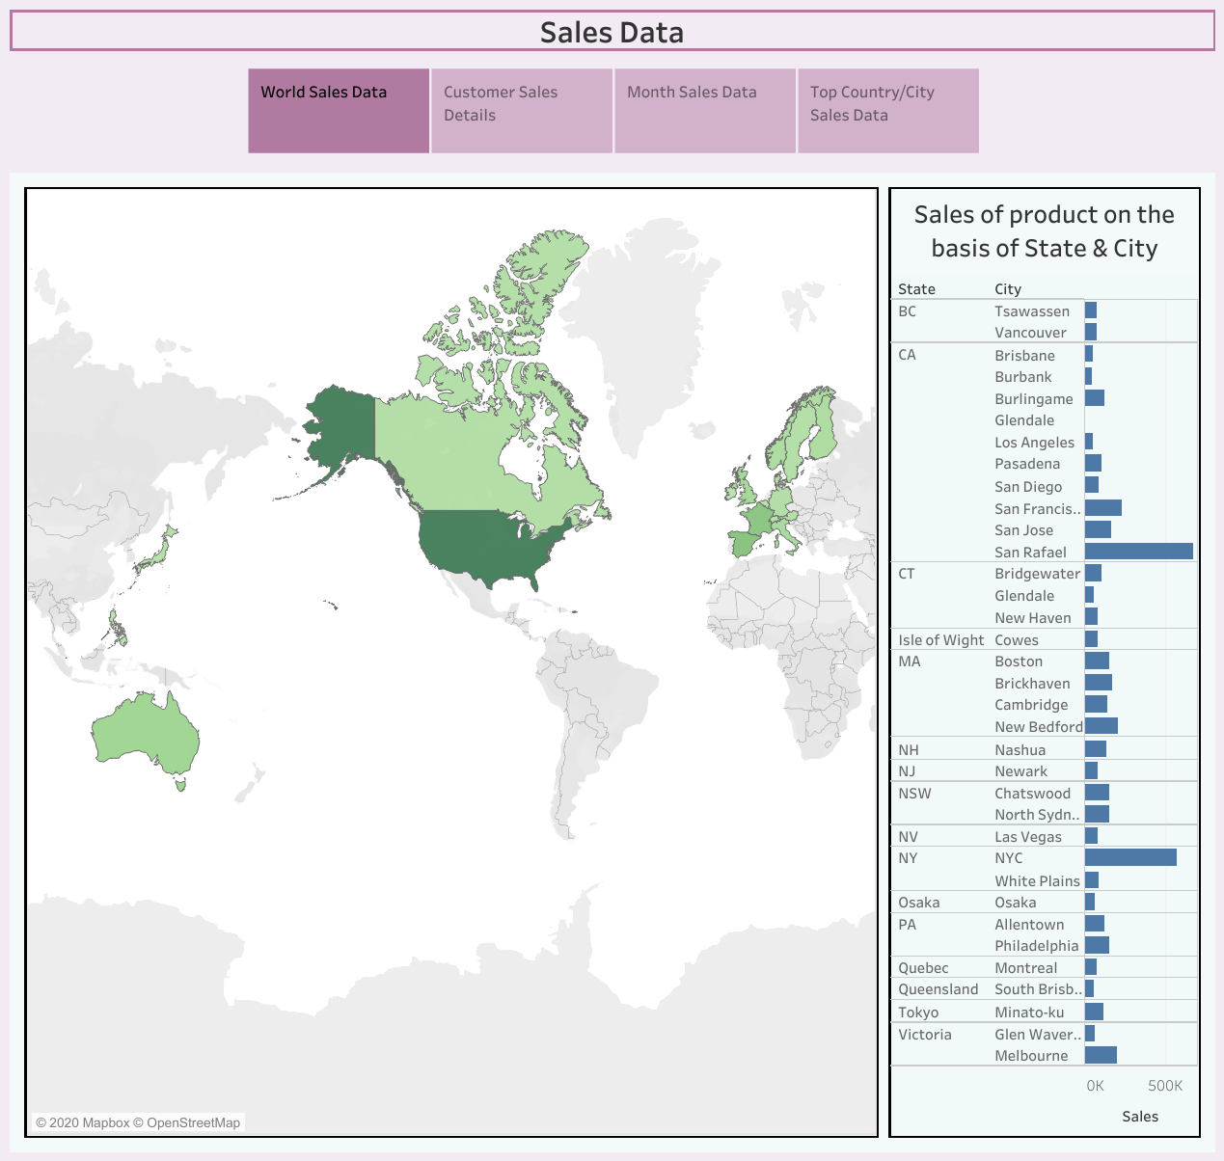
Top Country
USA
Top City
Madrid

Slide 5
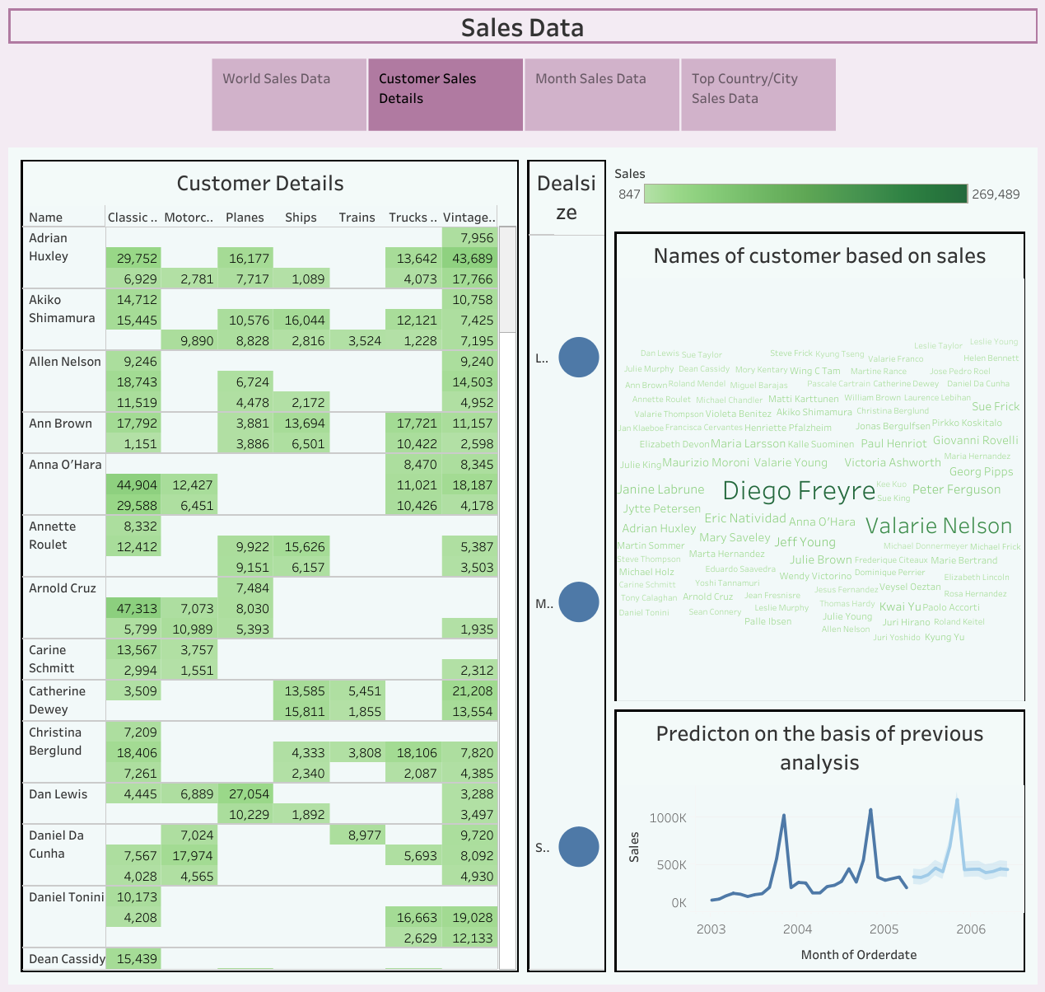
Top Costumers
Diego Freyre
Valarie Nelson
Total Sales:
Product:
Classic Cars
237,852
Total Sales:
Product:
153136
Classic Cars

Slide 6
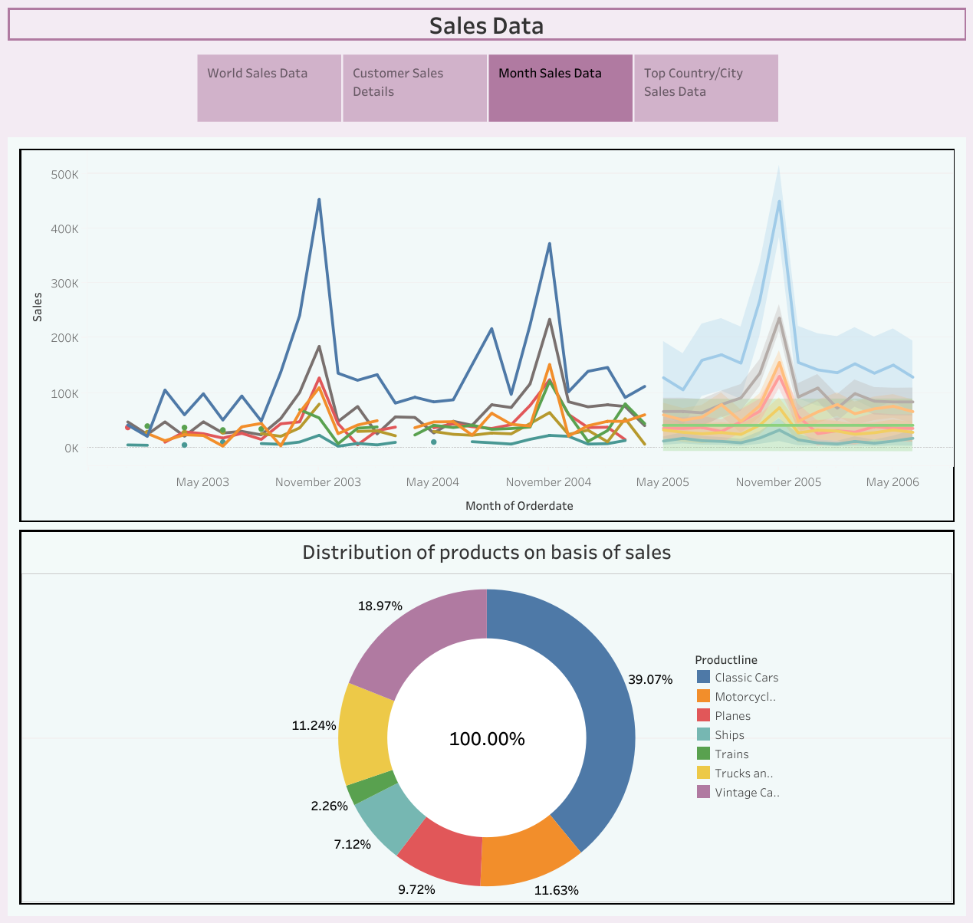
Sales Forecasting
Prediction on Different products based on previous sales.
Identified as Uniform pattern

Slide 7
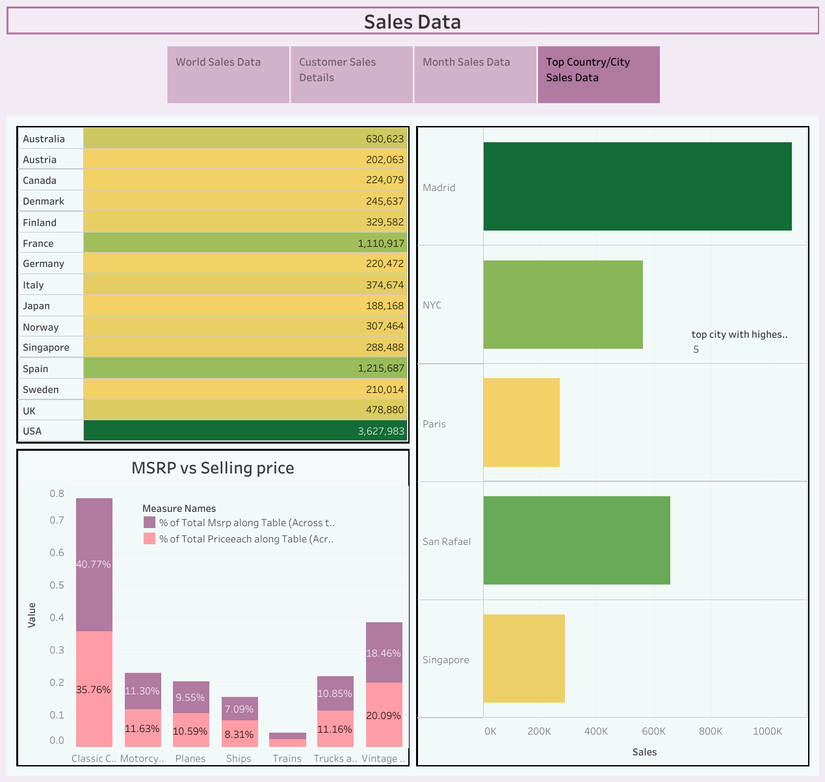
Top Countries & Cities to reach Highest Sales
Top Countries:
Top Cities:
U.S
Spain
France
Madrid
San Rafael
NYC

Slide 8
Thank You

